Slide 1
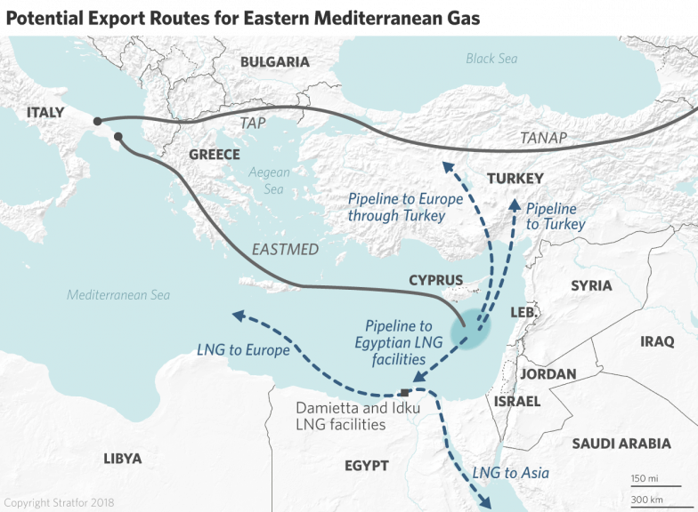
Straight to policy making: Cyprus case
Scope: Informing National Energy Plans on options for natural gas exploitation and high renewable penetration
Modules: Electricity, Heating and cooling, Transportation
Spatial scale: Modelled the individual power plants and their techno-economic characteristics
Temporal scale: Year divided in 63 time steps – 7 seasons, 2 day types (weekend and working day), several daily time brackets
Source: worldview.stratfor.com

Slide 2
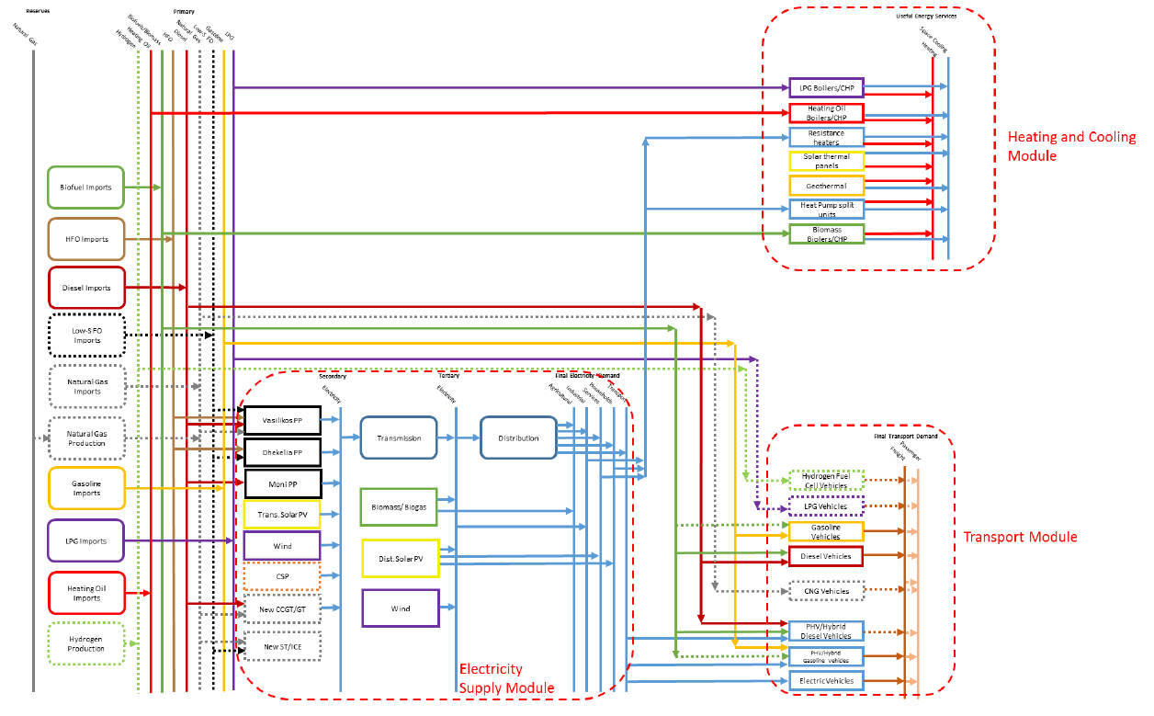
Straight to policy making: Cyprus case

